Slide 1

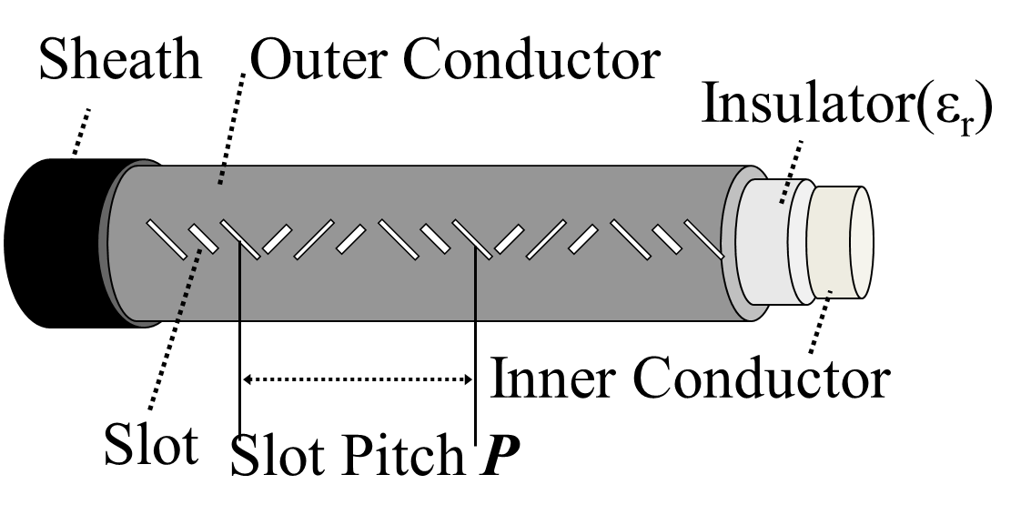
Improving Detection Accuracy using Subspace Method in LCX Based Positioning System of Radio Terminals
†
†
†
Shuhei Oki
Takeshi Higashino
Minoru Okada
†
Network Systems Laboratory, Graduate School of Information and Science, Nara Institute of Science and Technology
Background
Delay Time Estimation in Propagation Path
The spread of smart phone
The demand for position detection
using personal assistance is increasing.
Configuration of OFDM receiver
The service using position
information is provided.
Existing positioning system
GPS is not effective indoors.
The system using ZigBee or RFID needs many readers.
Proposal
Example of indoor positioning system using RFID
(AirLocation:Hitach corp.)
We estimate Δτ by using signal processing to
We use OFDM (Orthogonal Frequency Division Multiplexing) signals and Leaky Coaxial
Cable(LCX). By using them,
Application of subspace method in time domain under the condition that
the input signal series consist of complex sine wave and a complex white noise
we can decrease the number of base stations and develop radio area in the wide range.
we can provide wireless communication service and positioning service simultaneously.
Channel Response
Autocorrelation
matrix
Signal subspace
Noise subspace
: eigenvector of R
: eigenvalue of R only from a sine wave signal
Directivity of LCX
: variance of white noise
We decompose an autocorrelation matrix of channel response into
signal subspace and Noise subspace.
LCX has two directivity by
removing a terminator
： Pseudo response
Channel estimation using OFDM
subcarriers
IFFT vector
Channel response changes corresponding
to a terminal position.
Channel Response is multiplied by each
OFDM subcarriers.
We estimate terminal position using which shows a peak in pseudo response.
Principle of Detecting a Position
Channel response in propagation path
Derivation of estimated position using Δτ
Relationship between a terminal
position and Δτ
Δτ can be derived geometrically.
is periodic function and its period is
Target position can be
estimated if Δτ is known
(a) L=100m
(b) L=10m
Computer Simulation
The response in a certain position （20MHz）
Delay time
Δτ [μs] | [μs]
0.606 | 0.615
0.227 | 0.246
Target position
0.246
0.615
X [m] | [m]
20 | 18.8
70 | 67.5
(a) Raw frequency response
(b) Pseudo response
Measurement of accuracy in broad band WiFi system
Ex) 160MHz
(a) Relationship between target position and error
(b) Error and time resolution
ACKNOWLEDGMENT：This paper was supported by MIC SCOPE (Strategic Information and Communications R&D Promotion Programme)Grant number 135007001

