Slide 1
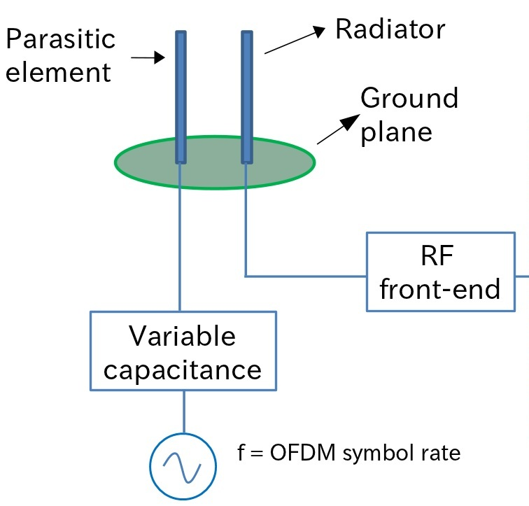
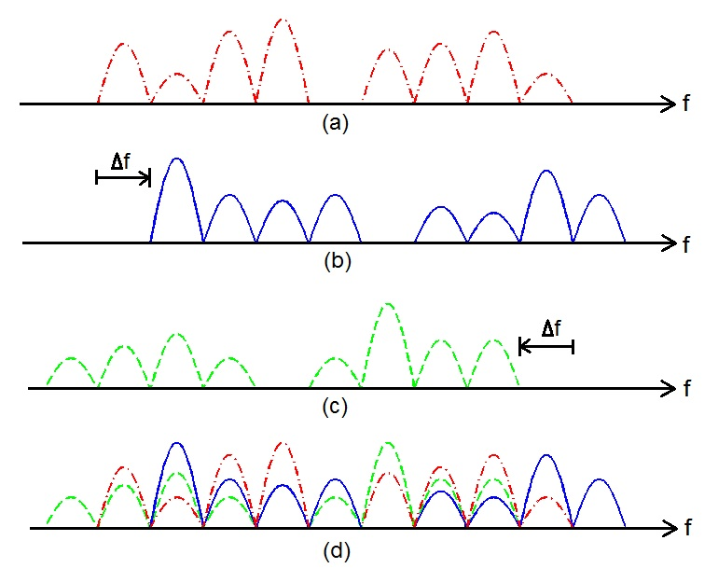
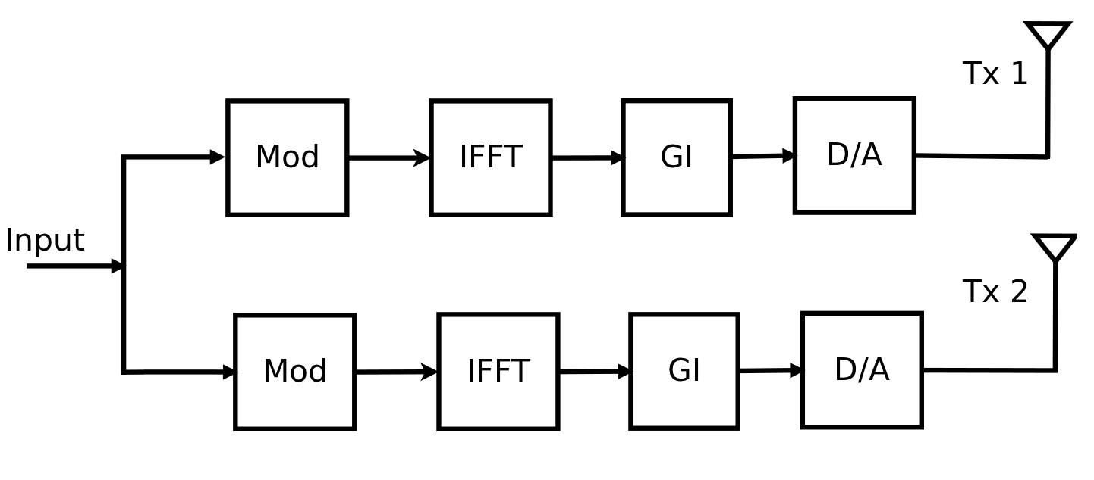
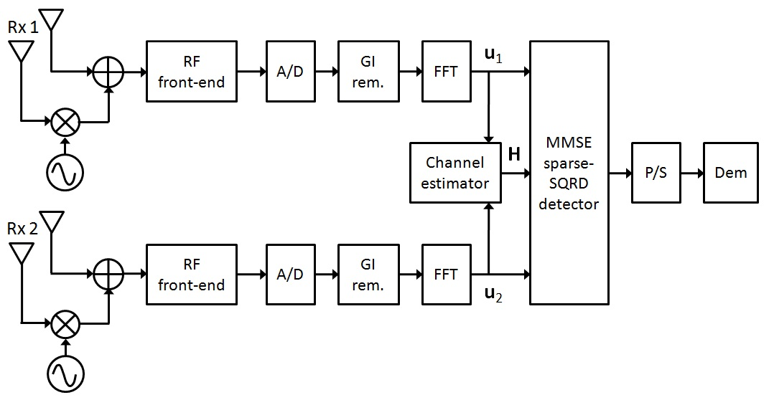
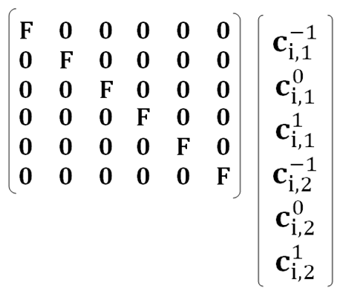
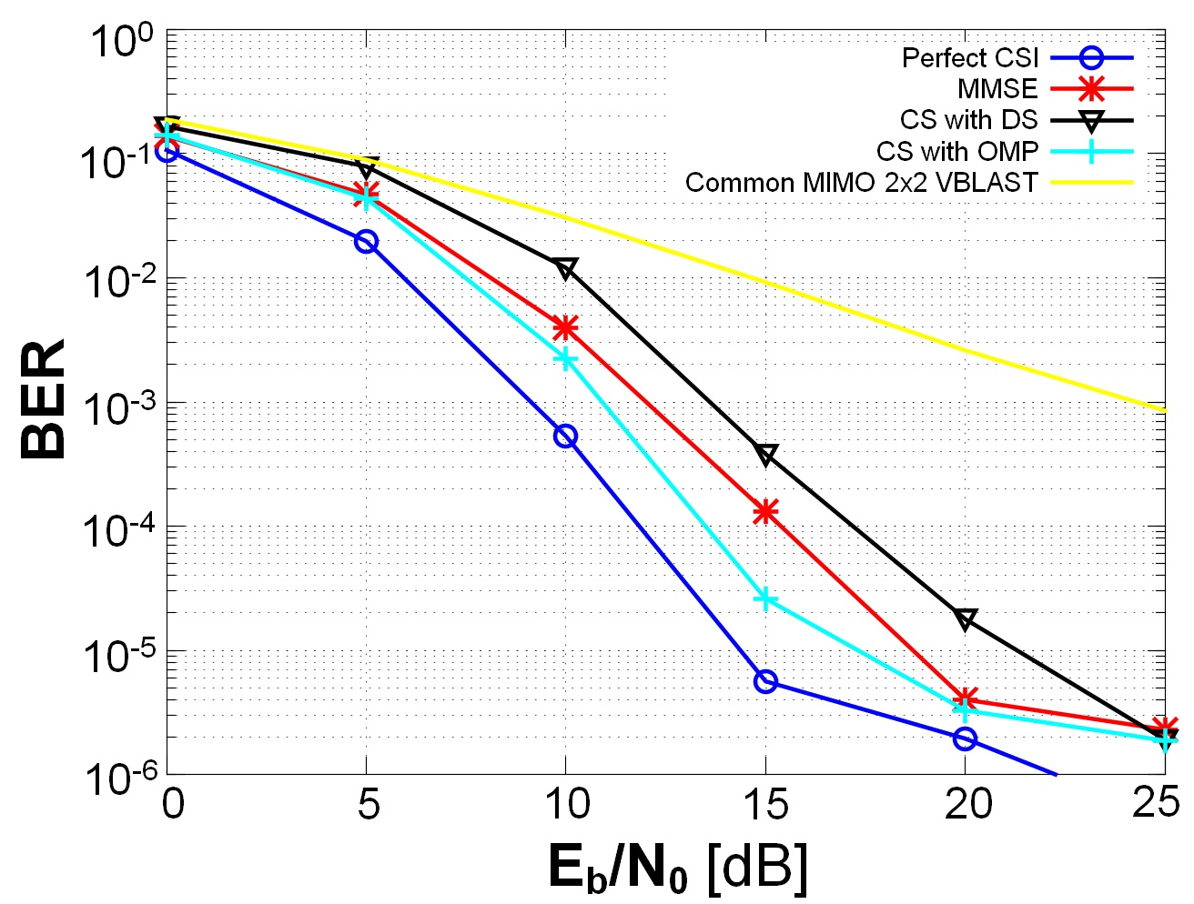
MIMO-OFDM with ESPAR Antenna
Diego Javier Reinoso Chisaguano, Takeshi Higashino and Minoru Okada
Nara Institute of Science and Technology, Graduate School of Information Science
Network Systems Laboratory
MIMO-OFDM with ESPAR antenna
ESPAR antenna with periodically changing directivity
In this scheme the directivity of the ESPAR antenna is changed by an oscillator which frequency is the OFDM symbol rate.
The periodic variation of the directivity causes Inter ICI in the received signal.
In the figure, (a) is the frequency non-shifted component, the positive and negative frequency shifted components are shown in (b), (c), and the total received signal in (d)
ESPAR(Electronically Steerable Passive Array Radiator).
It is a small size and low power consumption antenna.
It is composed by a radiator element connected to the RF front-end and one or more parasitic(passive) elements terminated by variable capacitances.
System model of MIMO-OFDM with ESPAR antenna
Compared to the conventional MIMO-OFDM 2x2 systems, MIMO-OFDM with ESPAR antenna gives additional diversity gain and improves the bit error rate performance without increasing the number of RF front-end circuits.
a) Transmitter
b) Receiver
For every receiver it uses a 2-elements ESPAR antenna with periodically changing directivity
It uses the low complexity MMSE sparse-SQRD algorithm for the detection process.
Based in the WLAN IEEE 802.11n standard
Compressed Sensing based channel estimation
Compressed Sensing (CS) is a set of new algorithms that allows the reconstruction of sparse signals from much fewer measurements.
For MIMO-OFDM with ESPAR antenna, when the pilot symbol is transmitted, the vector of received symbols at the i-th receiver and after the FFT block is given by
To exploit the sparsity of the channel impulse response, the previous equation can be expressed as
r
=
+
z
u_{i} = [G₋₁P₁ , G₀P₁ , G₁P₁ , G₋₁P₂ , G₀P₂ , G₁P₂]
Channel impulse response
F : N x L matrix part of the Fourier matrix.
N : number of sub-carriers
L : number of channel taps.
r: observation vector of size n
: n x p measurement matrix. (n<<p)
: sparse unknown vector of size p
z: noise vector
To solve the previous equation, Dantzig Selector (DS) or Orthogonal Matching Pursuit (OMP) algorithms can be used.
Simulation Results
Simulation Settings
Parameter | Value
Modulation | 16-QAM
Channel bandwidth | 20MHz
Pilot Sequence | HTLTF, P2 Cyclic Shift 850nS
Number of sub-carriers | 56
FFT size | 64
GI | 1/4
Path model | 2 rays Rayleigh frequency selective Fading
Noise type | AWGN
Channel Estimation | MMSE, perfect CSI, CS with L = 16
Detection | MMSE sparse-SQRD
16dB
For a BER of 10⁻³ and using perfect CSI, MIMO-OFDM with ESPAR antenna achieves an additional diversity gain of 16dB compared to a common MIMO 2x2 VBLAST system.
Using CS-based channel estimation with OMP we obtain better estimation accuracy and it improves the BER compared to the MMSE channel estimator.

